Slide 1

Methodology
easy but important
Jean-Yves Le Boudec
2021

Slide 2
Contents
What is performance evaluation about ?
Factors
The Scientific Method
Patterns

Slide 3
Two Examples
Compare Windows versus Linux
Evaluate the power consumption of a telecom «box»
How would you tackle these problems ?
What do you need to be careful about ?

Slide 4
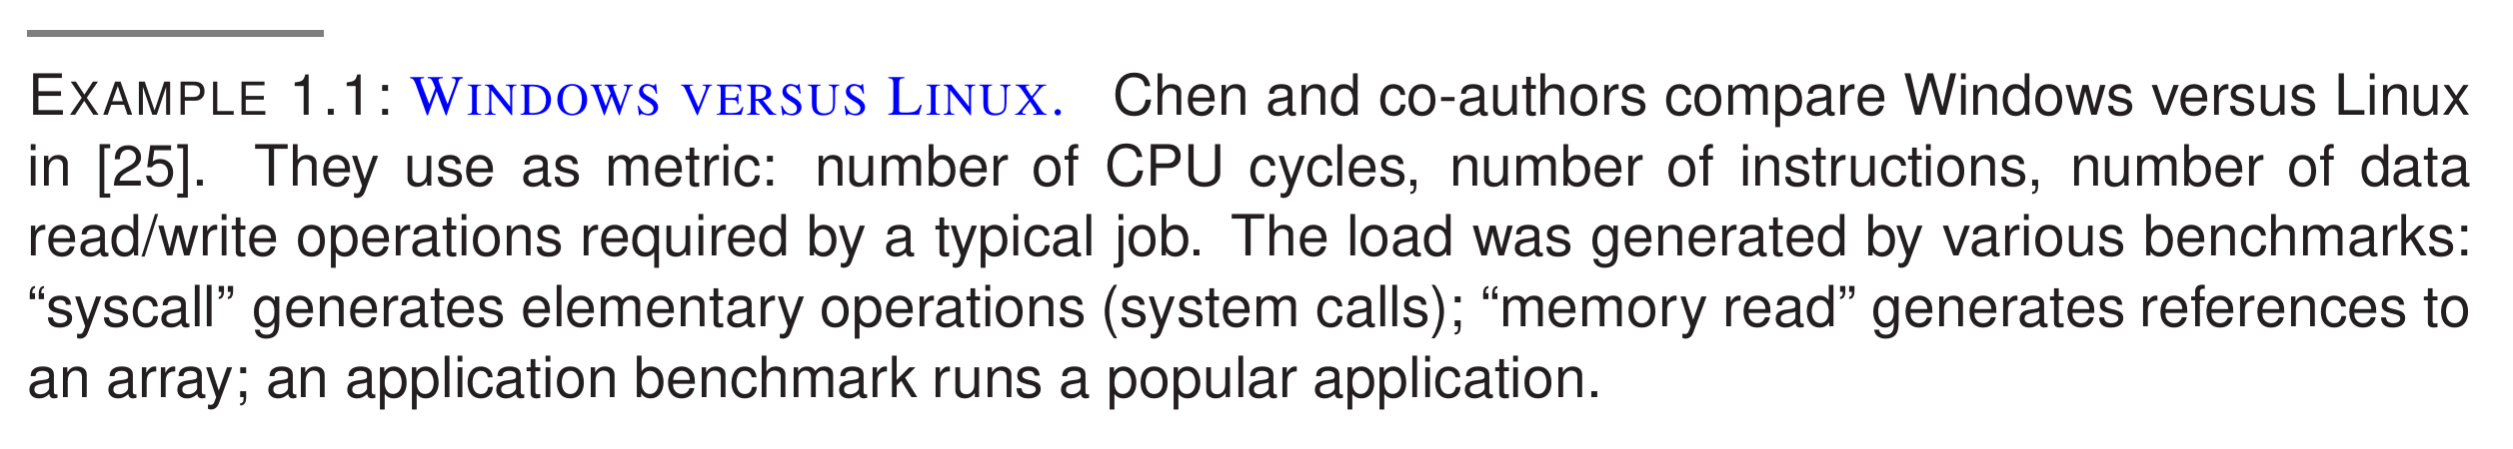
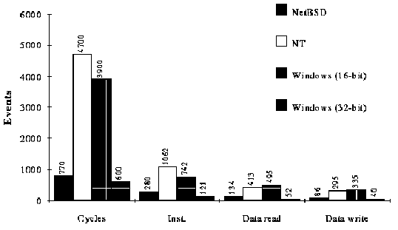
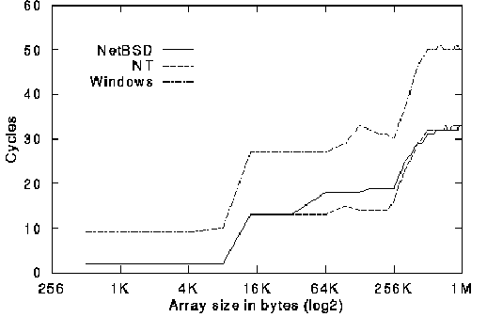
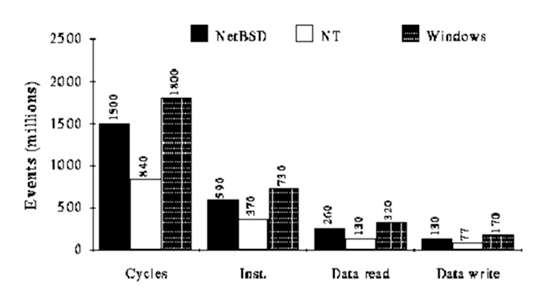
Example 1
Syscall Benchmark
ghostview
memory read

Slide 5
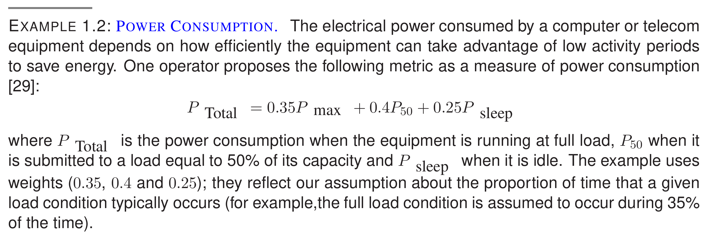
Example 2

Slide 6
Metric
Define a metric; examples
Response time
Power consumption
Throughput
Define operational conditions under which metric is measured (« Viewpoint », see Chapter 11)

Slide 8
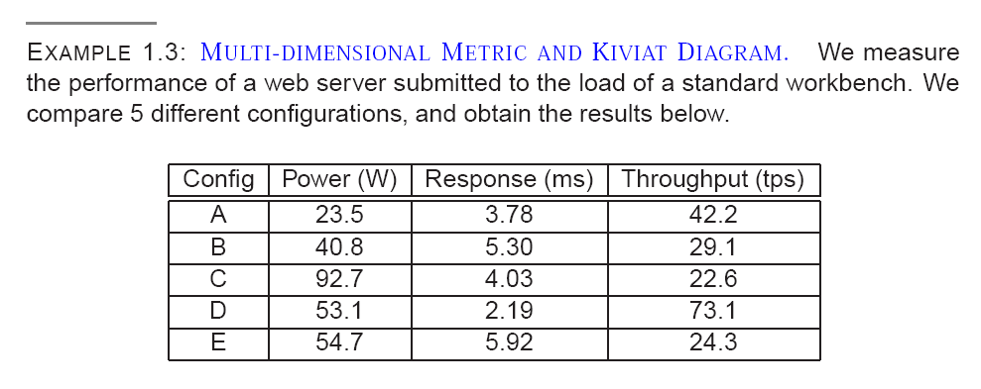
Which configuration is best ?
A
B
C
D
E
None of the above
I don’t know

Slide 9
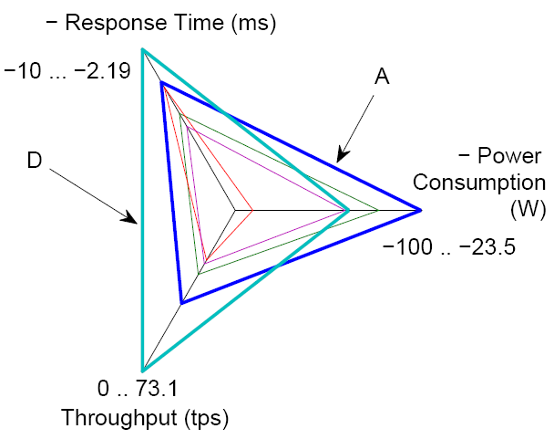
Answer F
Use a spider plot (Kiviat diagram) where large is good for every metric

Slide 10
Non-dominated metric
Often, metric is multi-dimensional.
A metric vector is non dominated i.e. there is no other metric vector that is better in all dimensions.
Configurations A and D are non dominated. They are the only configurations of interest.

Slide 11
Load
You need to define the load under which your system operates

Slide 12
Know your goals
Goal in Example 1.1 is to make a comparison
Goal in Example 1.2 is to provide an engineering rule

Slide 13
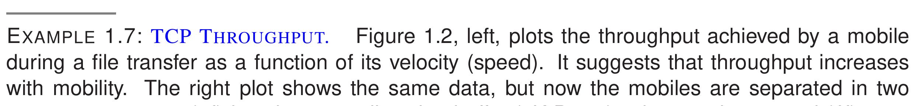
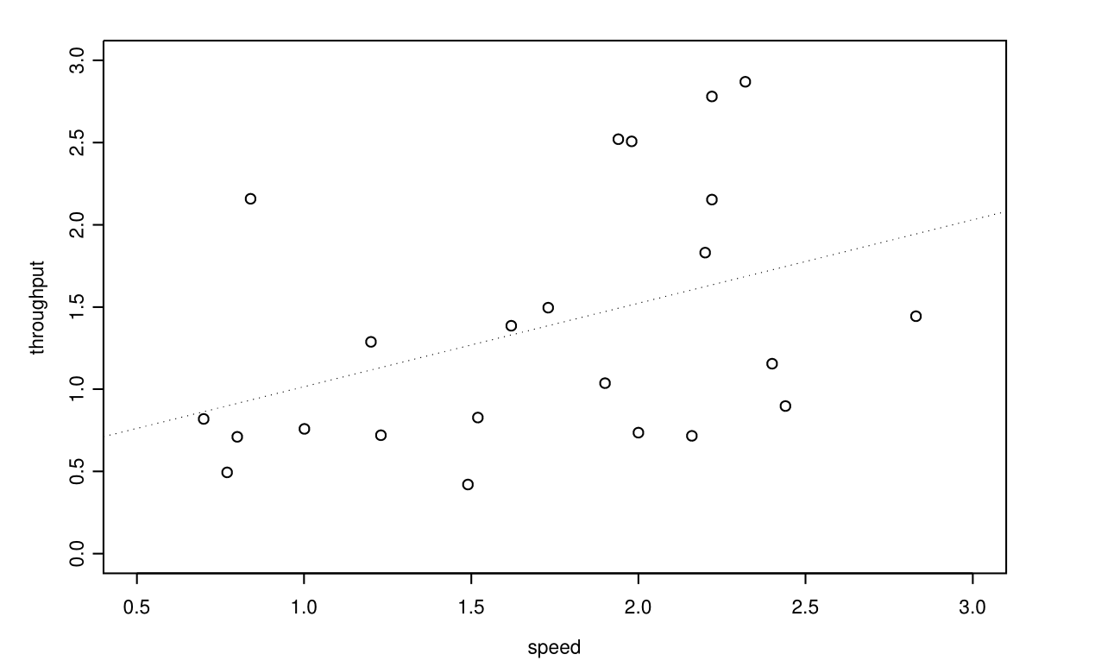
2. Factors TCP Throughput Increases with Mobility

Slide 14
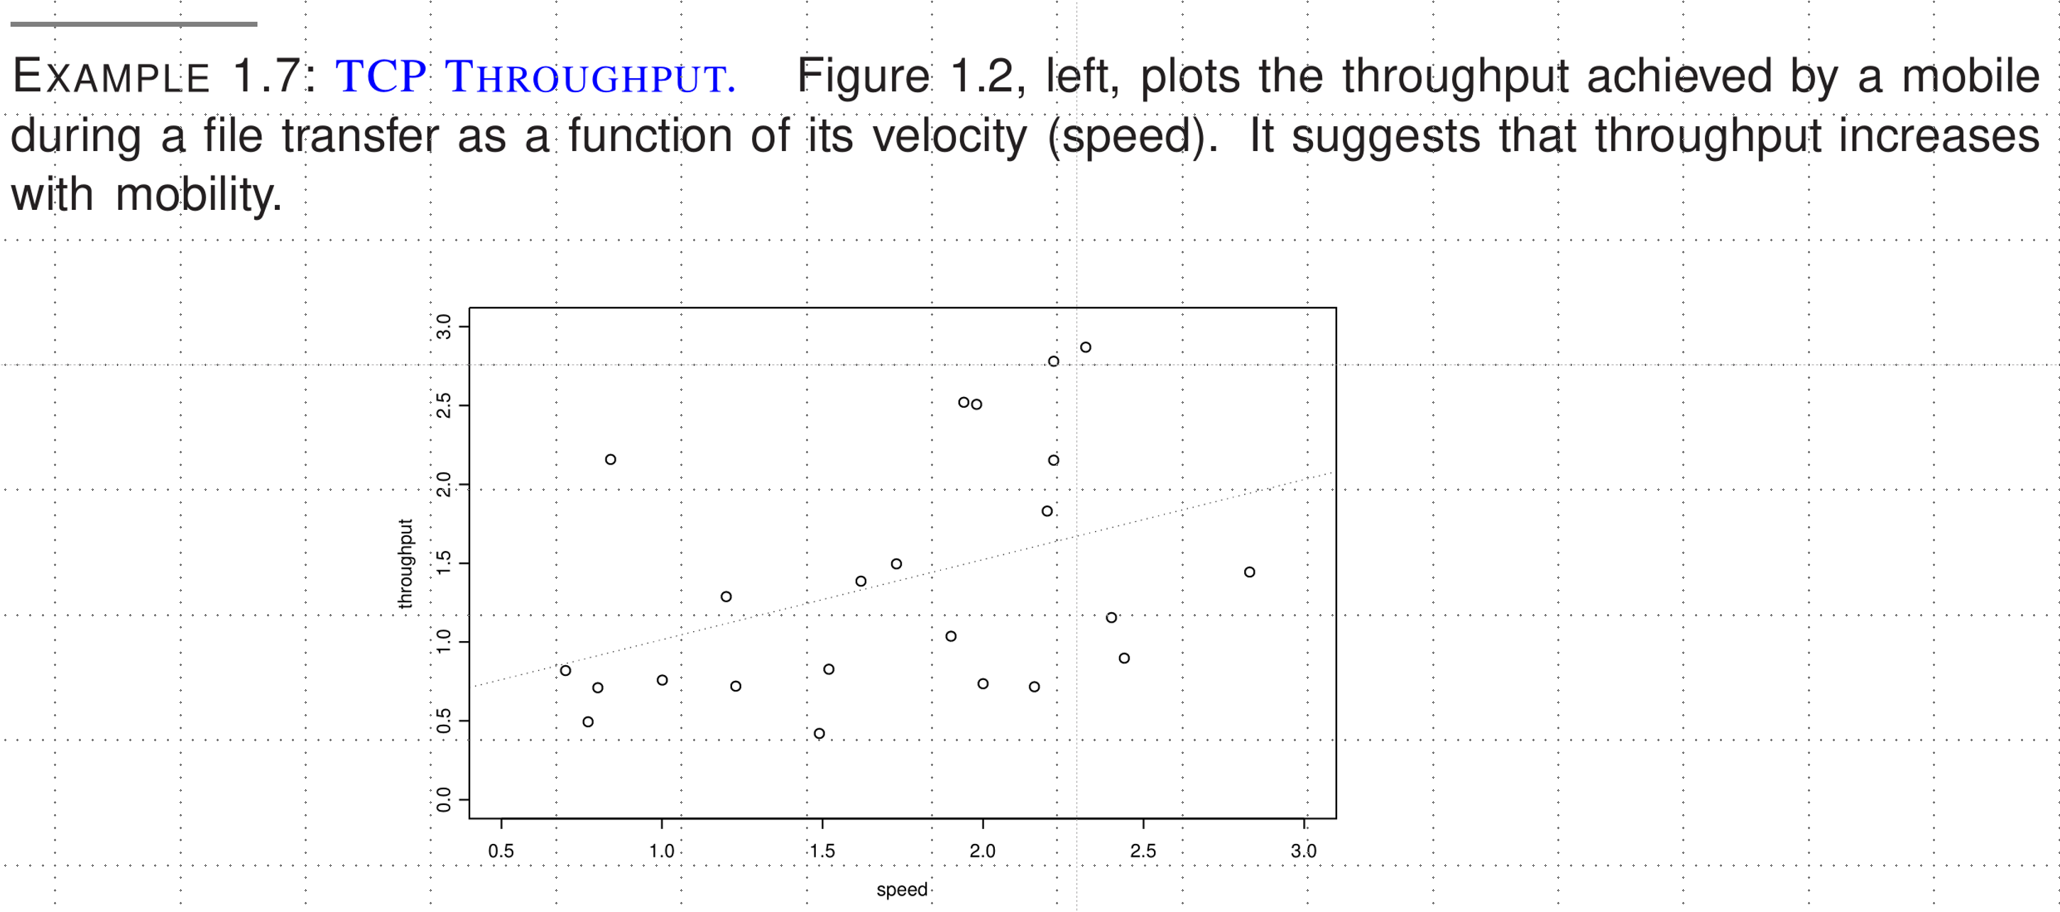
Does mobility increase throughput ?
Yes, as proven by this experiment
It is true but perhaps only for a very specific system
No, it is not true
I don’t know

Slide 15
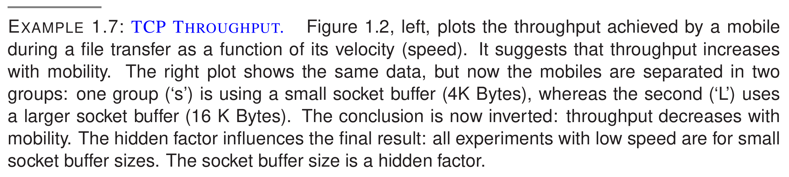
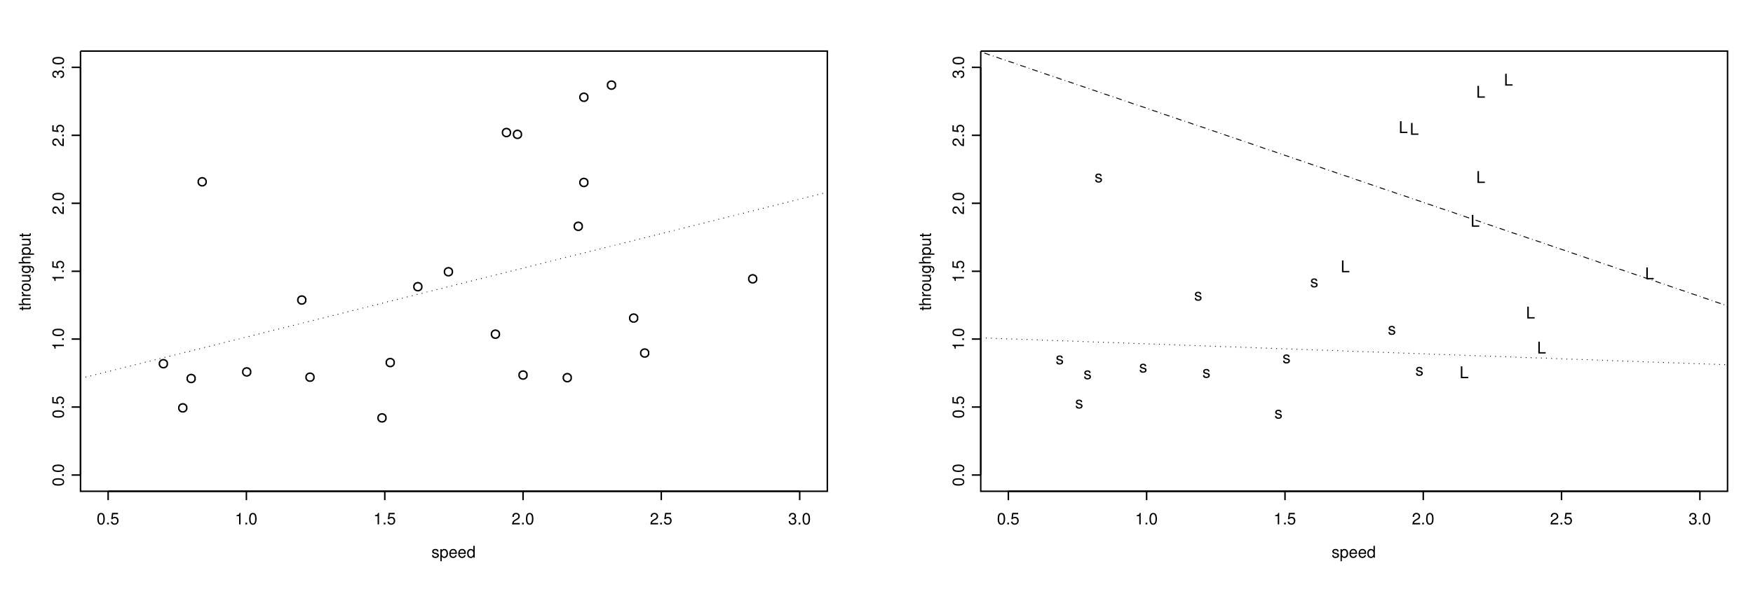
Answer C

Slide 16
Why were we fooled ?
Hidden factor had a more important role than the factor we were interested in
Factor: an element that may impact the performance
(desired factors): speed of user, intensity of load, number of servers …
(nuisance factors): socket buffer size, time of the day …
We interpreted correlation as causality
Need to be aware of all factors and incorporate in the analysis
Or randomize experiment to reduce impact of hidden factors

Slide 17
Simpson’s Paradox
A well known phenomenon -- Special case of Hidden Factor paradox when metric is success rate and factors are discrete.
Ex: UC Berkeley gender bias case 1973
Women are less likely to be admitted at university
But at every department, women are equally or more likely to be admitted

Slide 18
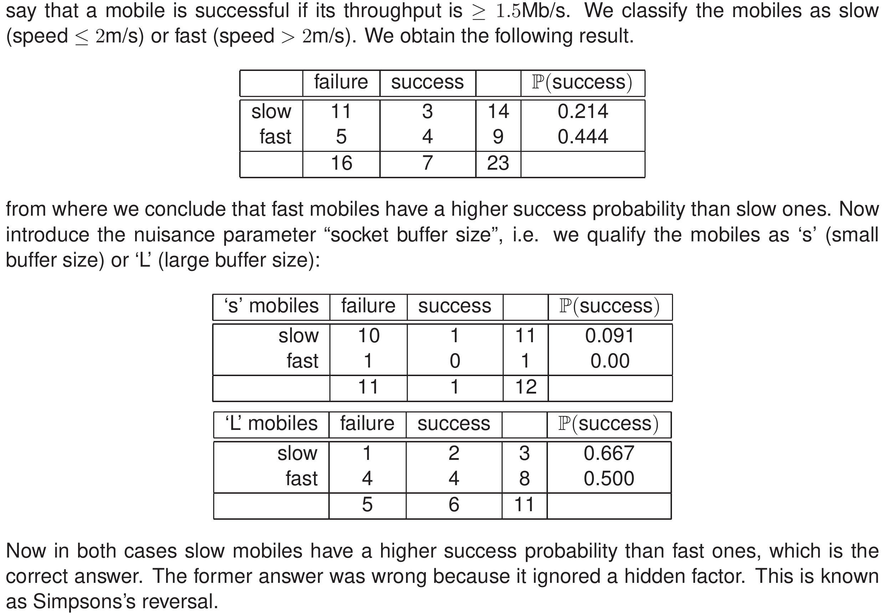
Simpson’s paradox with TCP throughput on mobiles

Slide 19
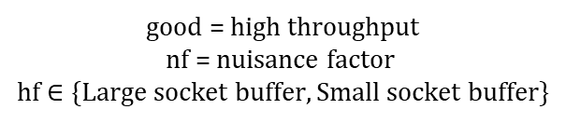
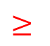
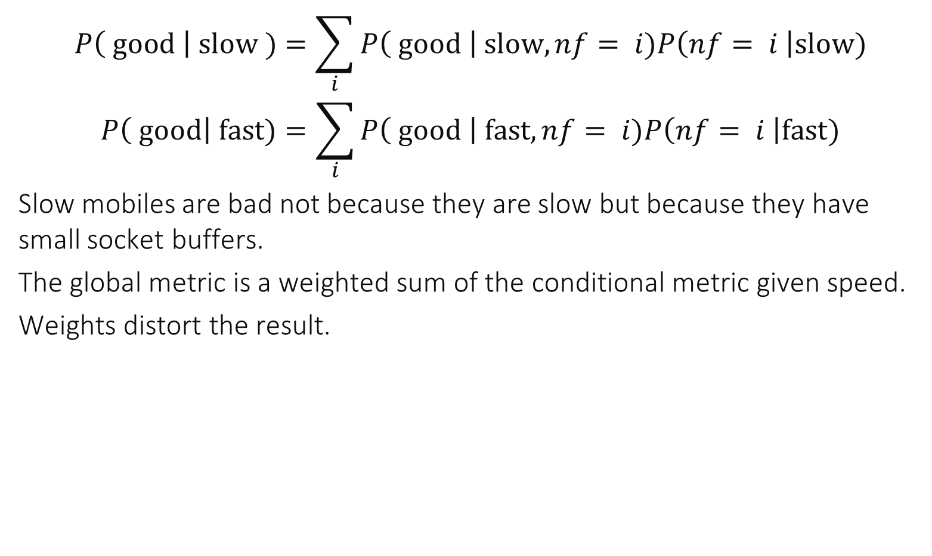
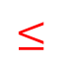
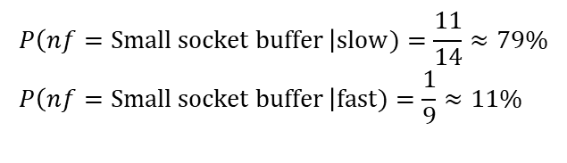
Simpson’s paradox explained
$$P\left( good \right| slow )=\sum_{i}{P\left( good \right| slow, nf= i)P\left(nf= i \right|slow)}$$
$$P\left( good\right| fast)=\sum_{i}{P\left( good \right| fast, nf= i)P\left(nf= i \right|fast)}$$
Slow mobiles are bad not because they are slow but because they have small socket buffers.
The global metric is a weighted sum of the conditional metric given speed.
Weights distort the result.
$$≤$$
$$≥$$
Different weights
good = high throughput nf = nuisance factor hf $∈\{Large socket buffer, Small socket buffer\}$
$$P\left(nf=Small socket buffer \right|slow)=\frac{11}{14}≈79\% \\ P\left(nf=Small socket buffer \right|fast)=\frac{1}{9}≈11\%$$

Slide 20

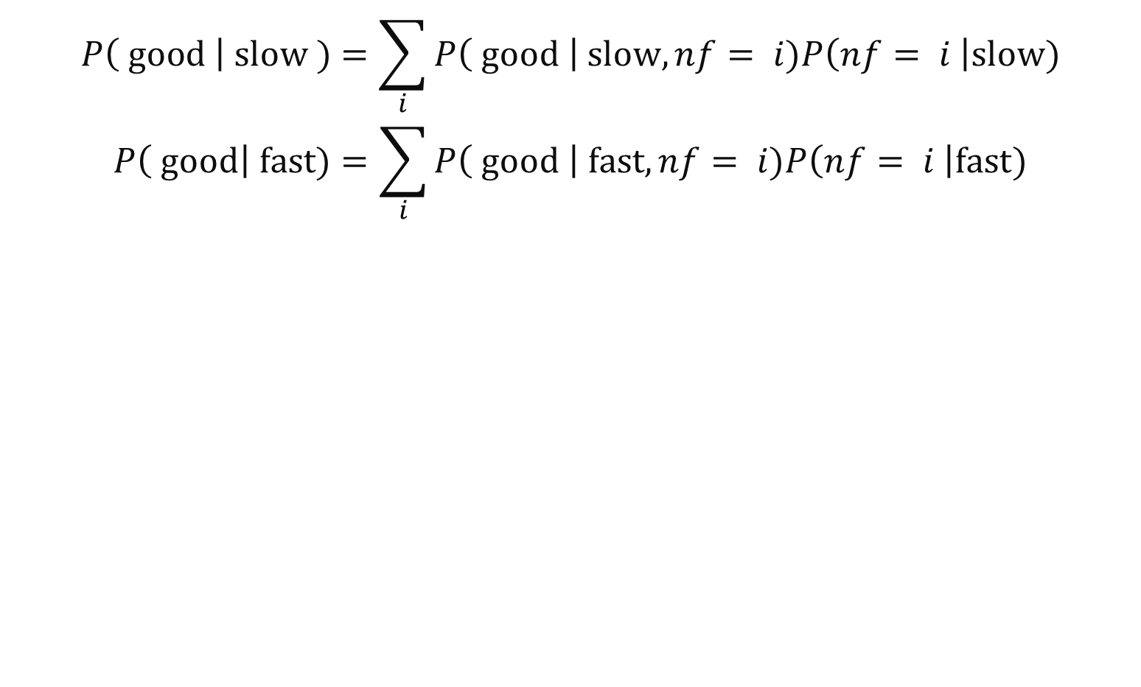
Avoiding Simpson’s Paradox
$$P\left( good \right| slow )=\sum_{i}{P\left( good \right| slow, nf= i)P\left(nf= i \right|slow)}$$
$$P\left( good\right| fast)=\sum_{i}{P\left( good \right| fast, nf= i)P\left(nf= i \right|fast)}$$
Make the weights equal ! $$P\left(nf=i | slow\right)=P\left(nf=i | fast\right), ∀i$$

Slide 21
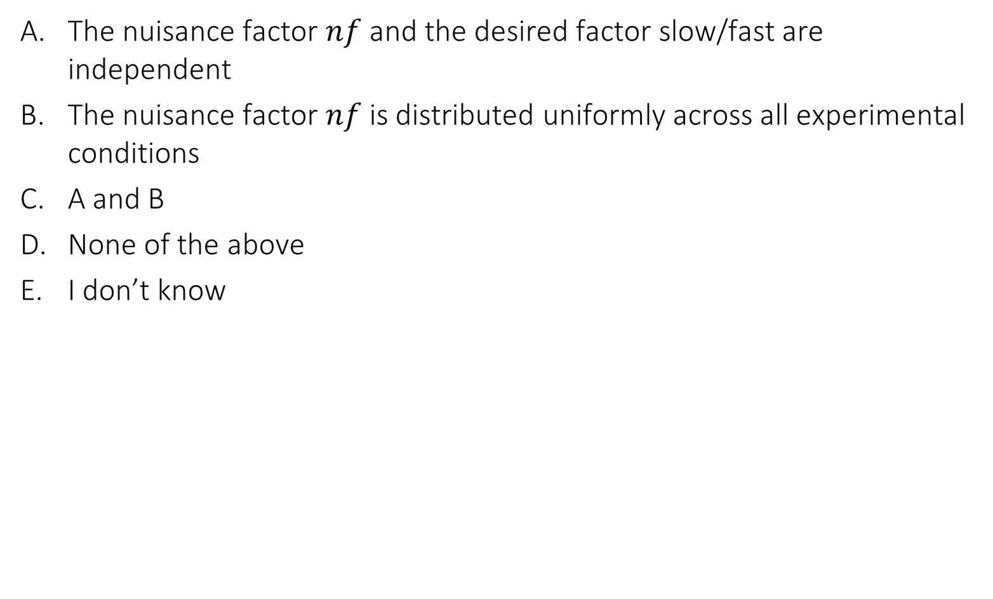
𝑃(𝑛𝑓=𝑖│slow)=𝑃(𝑛𝑓=𝑖│fast), ∀𝑖 means …
The nuisance factor $nf$ and the desired factor slow/fast are independent
The nuisance factor $nf$ is distributed uniformly across all experimental conditions
A and B
None of the above
I don’t know

Slide 22
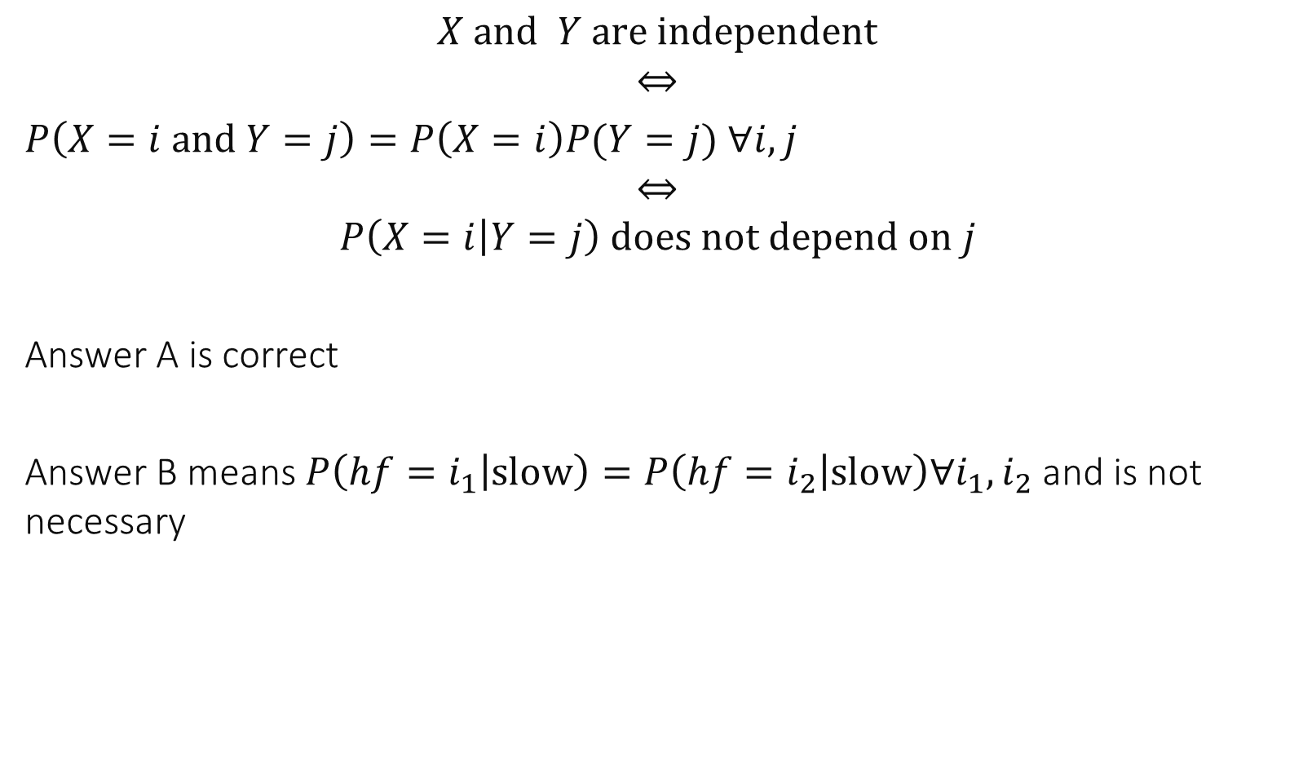
$$X and Y are independent$$
$$⇔$$
$P\left(X=i and Y=j\right)=P\left(X=i\right)P(Y=j)$ $∀i,j$
$$⇔$$
$$P\left(X=i | Y=j\right) does not depend on j$$
Answer A is correct
Answer B means $P\left(hf=i_{1} | slow\right)=P\left(hf=i_{2} | slow\right)∀i_{1},i_{2}$ and is not necessary

Slide 23
Avoiding Simpson’s Paradox
Make the weights equal =
ensure that nuisance factor is independent of desired factor.
For example: assume the desired factor is not controlled (imposed by experimental conditions) but the nuisance factor can be chosen freely:
choose the value of the nuisance factor by drawing at random from a distribution, same for every value of desired factor.
e.g: the probability of choosing S for a slow is the same as for a fast (instead of 79% and 11%)

Slide 24
Take-Home Message
Identify hidden factors – make them disappear if you can
else make them appear explicitly in the analysis,
or randomize the experiments to neutralize their impact (i.e. make the nuisance factors independent of the desired factors)

Slide 25
Take Home Message
Performance evaluation uses the language of probabilities
In this course we will exercise how to use probability theory in practice to do scientific work
These are the same fundamentals as data science

Slide 26





Putting Things Together A Performance Evaluation Study…
Goals
Load
Metric
System under study
Factors

Slide 27
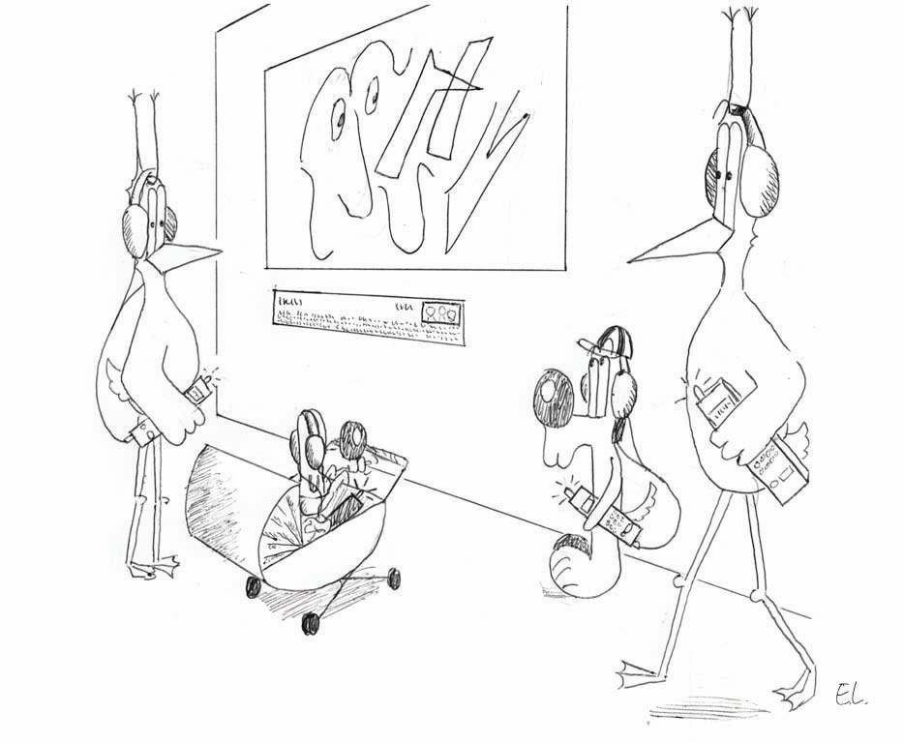
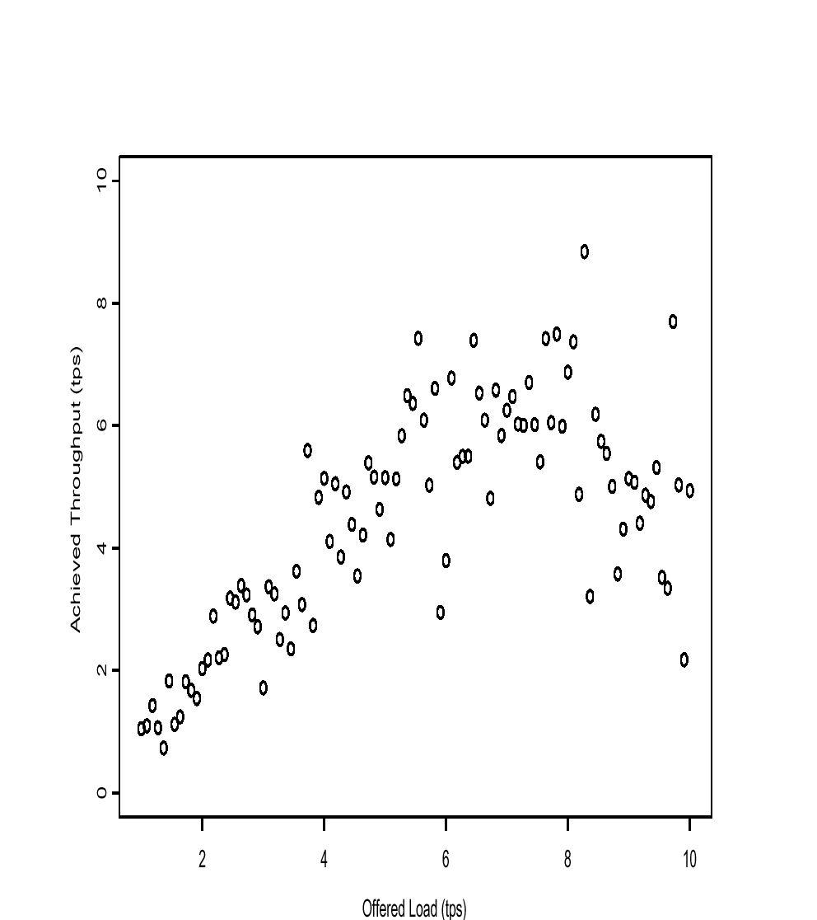
3. The scientific method
Joe measures performance of his Wireless Shop:

Slide 28

What do you recommend to Joe ?
Buy more access points
Change your server
Call infomaniak.ch
Live with it
I don’t know

Slide 29
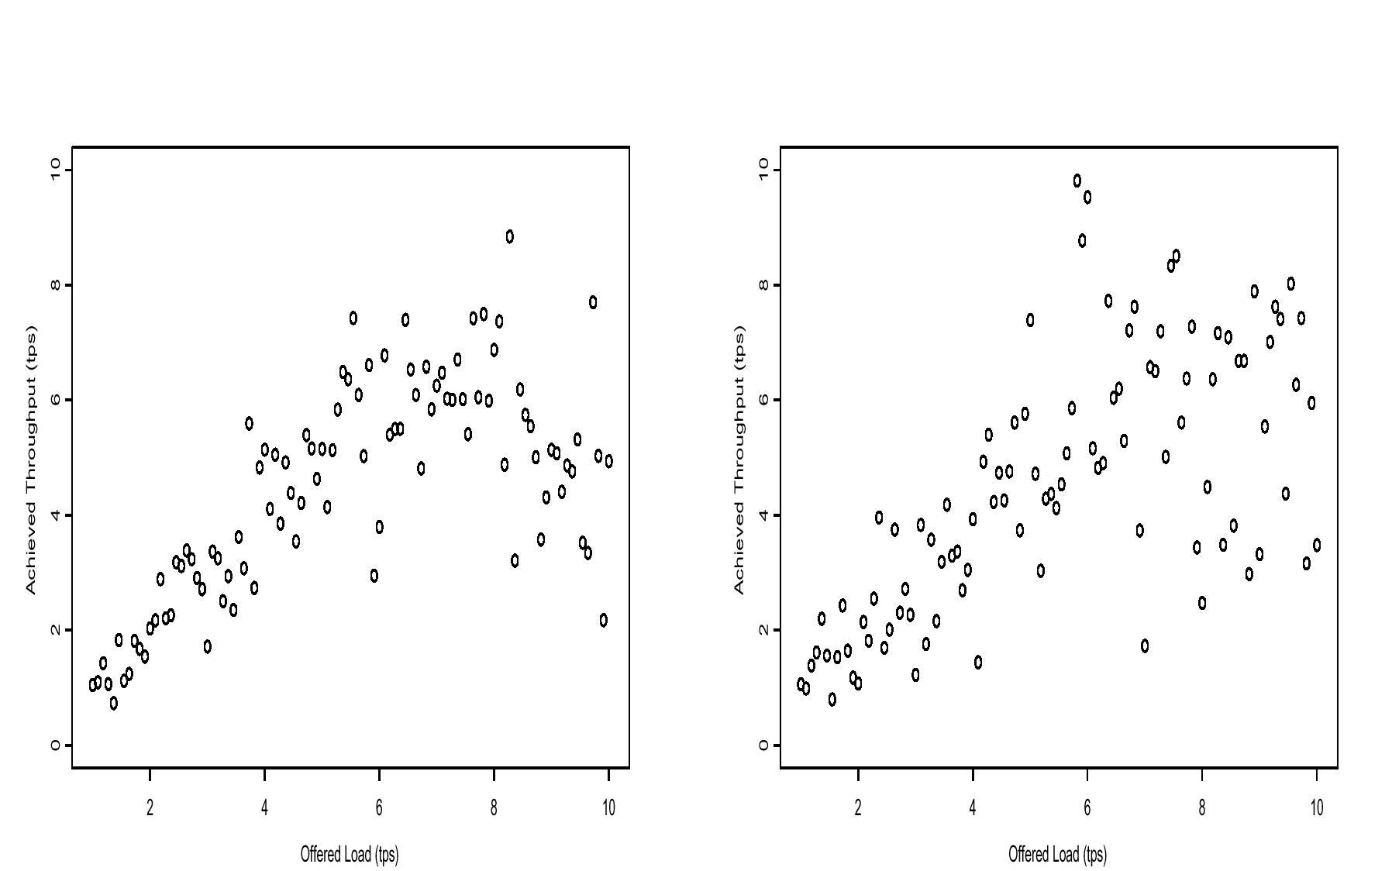
Joe’s solution: buy 2 more access points
Before
After

Slide 30
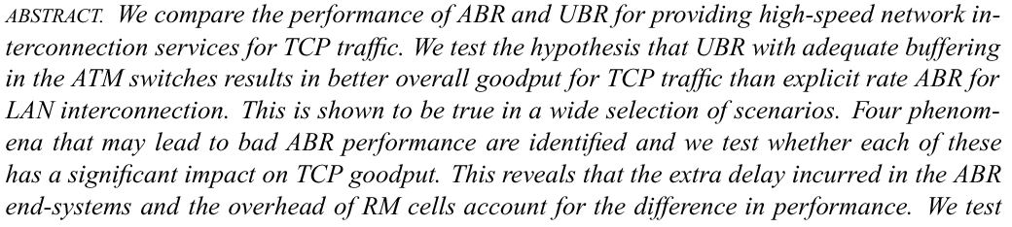
Example 2: Is ATM-ABR better than ATM-UBR ?

Slide 31
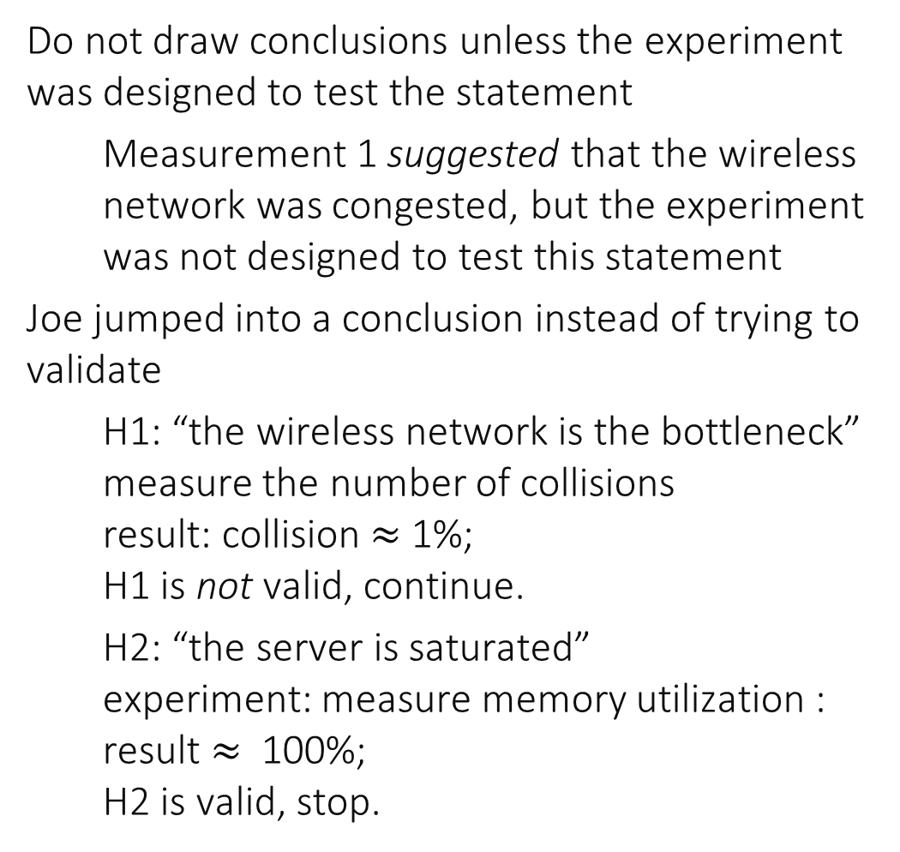
Scientific Method
Do not draw conclusions unless the experiment was designed to test the statement
Measurement 1 suggested that the wireless network was congested, but the experiment was not designed to test this statement
Joe jumped into a conclusion instead of trying to validate
H1: “the wireless network is the bottleneck” measure the number of collisions result: collision $≈$1%; H1 is not valid, continue.
H2: “the server is saturated” experiment: measure memory utilization : result $≈$ 100%; H2 is valid, stop.
Scientific Method:
do define hypotheses; design experiments; validate
until validation is OK

Slide 32
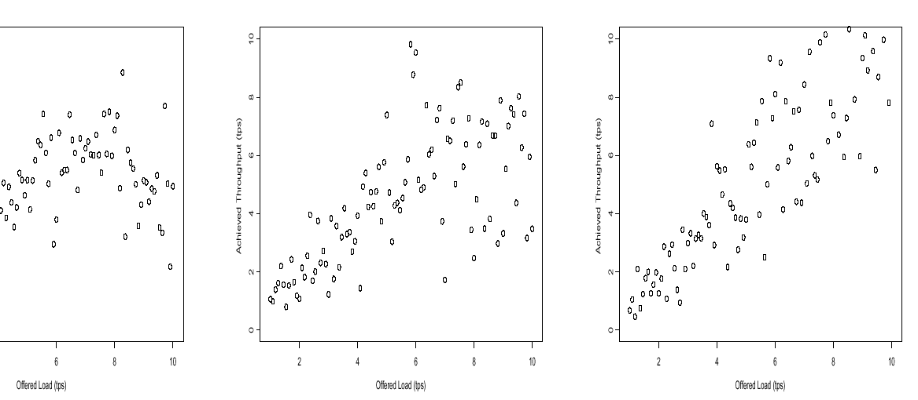
Performance After Doubling Server Memory

Slide 33
4. Patterns
These are common traits found in different situations
Knowing some of them may save a lot of time

Slide 34
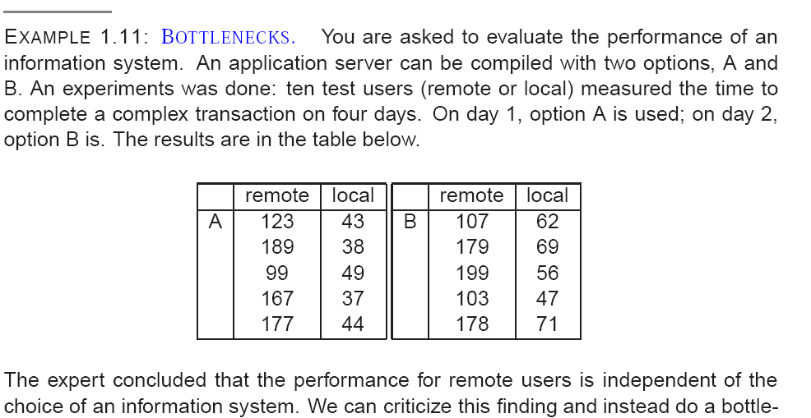
What we are measuring here is the bottleneck, not the intended factor !

Slide 35
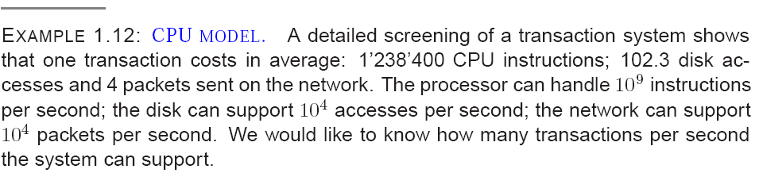
How do you proceed ?
Do a queuing theory analysis
Do a simulation
None of the above
I don’t know

Slide 36
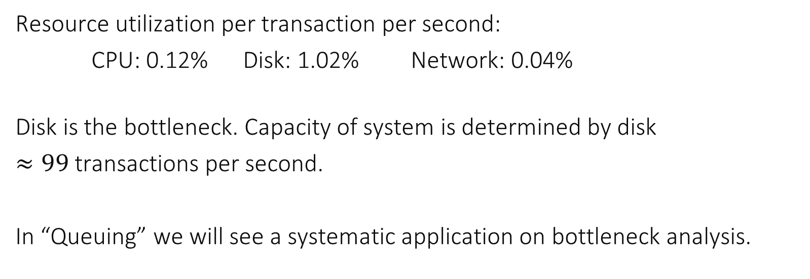
Resource utilization per transaction per second:
CPU: 0.12% Disk: 1.02% Network: 0.04%
Disk is the bottleneck. Capacity of system is determined by disk
$≈99$ transactions per second.
In “Queuing” we will see a systematic application on bottleneck analysis.

Slide 37
Bottlenecks may be your Friends
Look for bottlenecks to avoid gross errors !
Simplify your life, analyze bottlenecks !

Slide 38

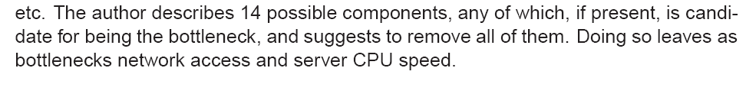
Behind a Bottleneck May Hide Another Bottleneck

Slide 39
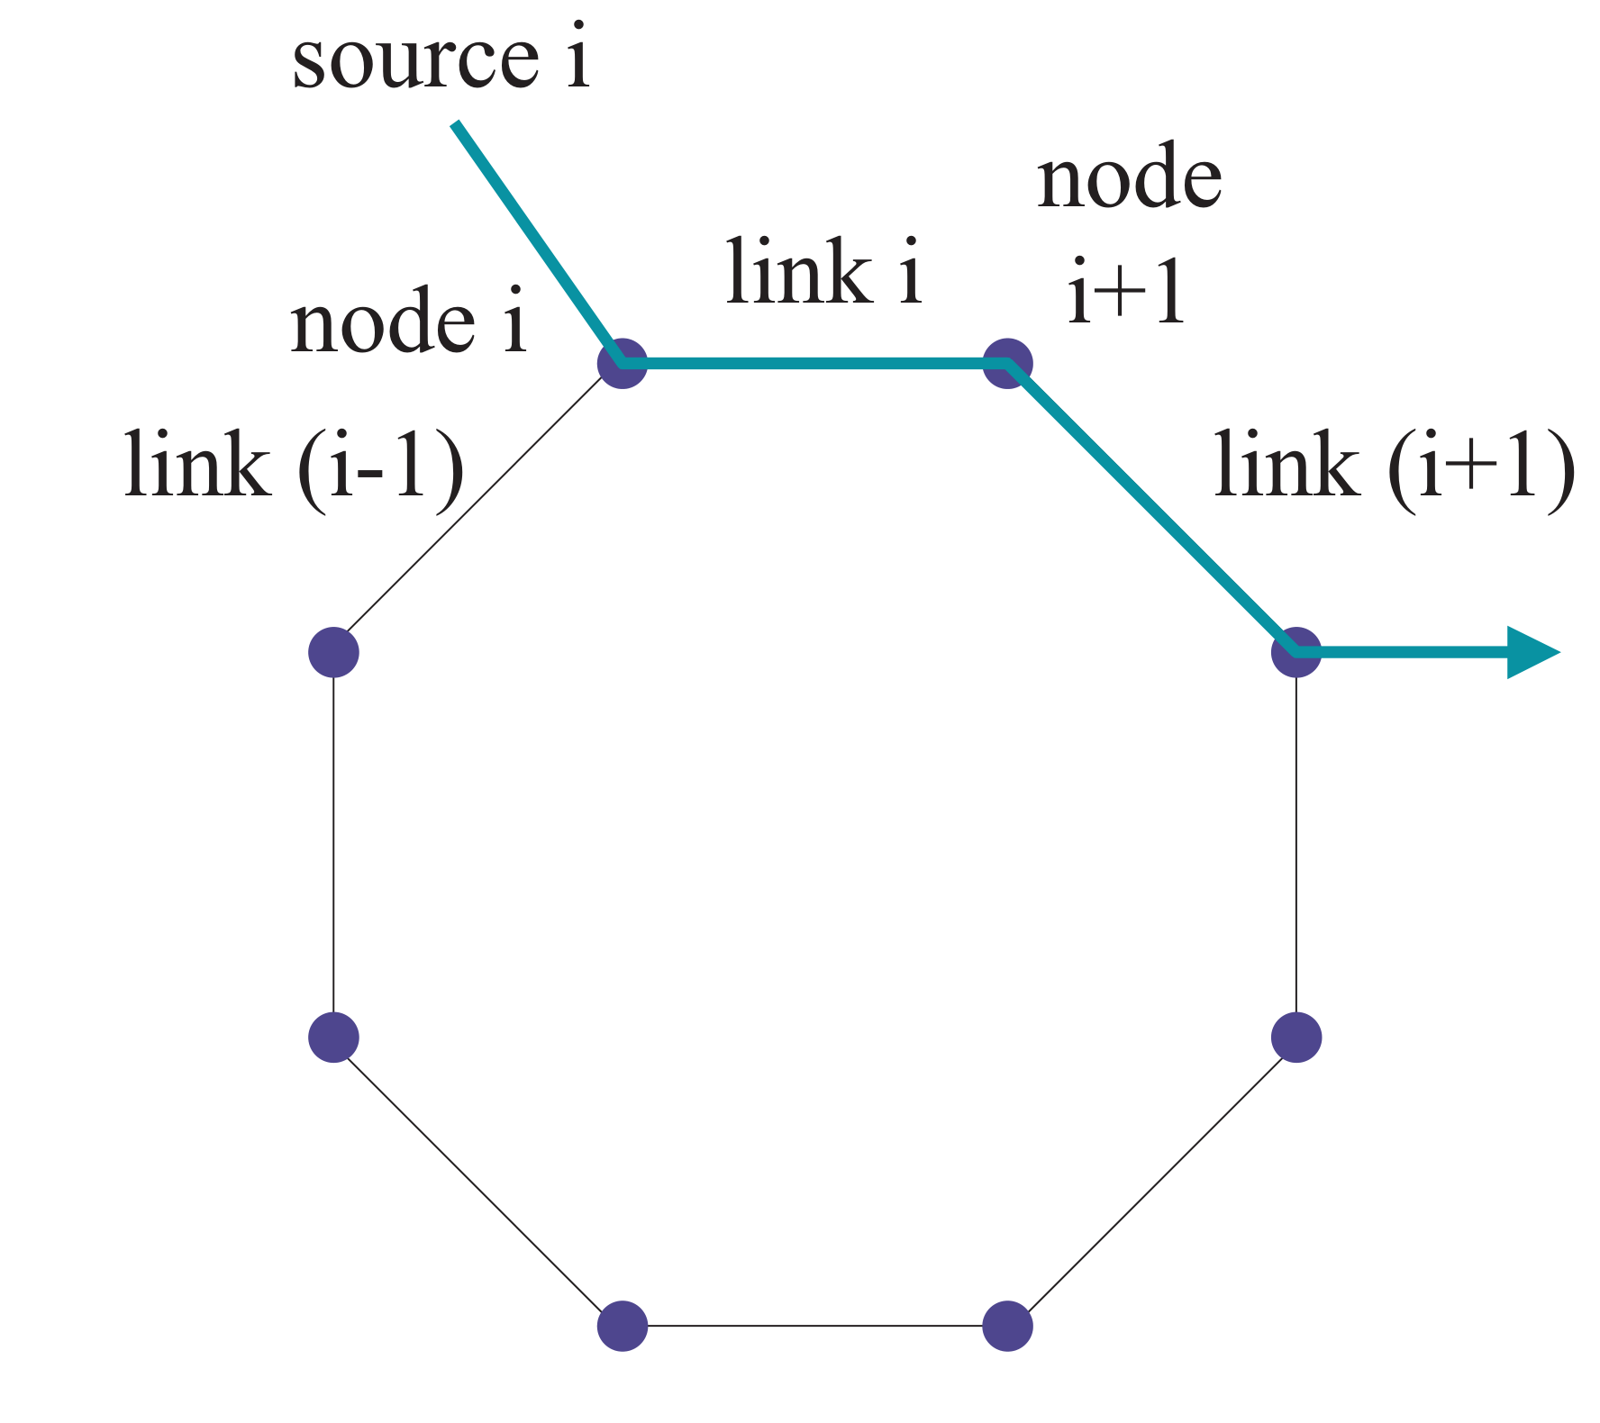
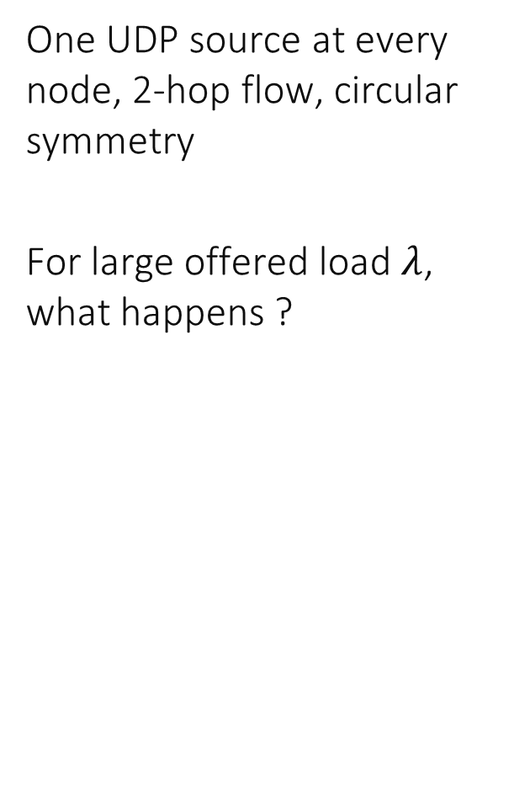
Another Pattern
One UDP source at every node, 2-hop flow, circular symmetry
For large offered load $λ$, what happens ?

Slide 40
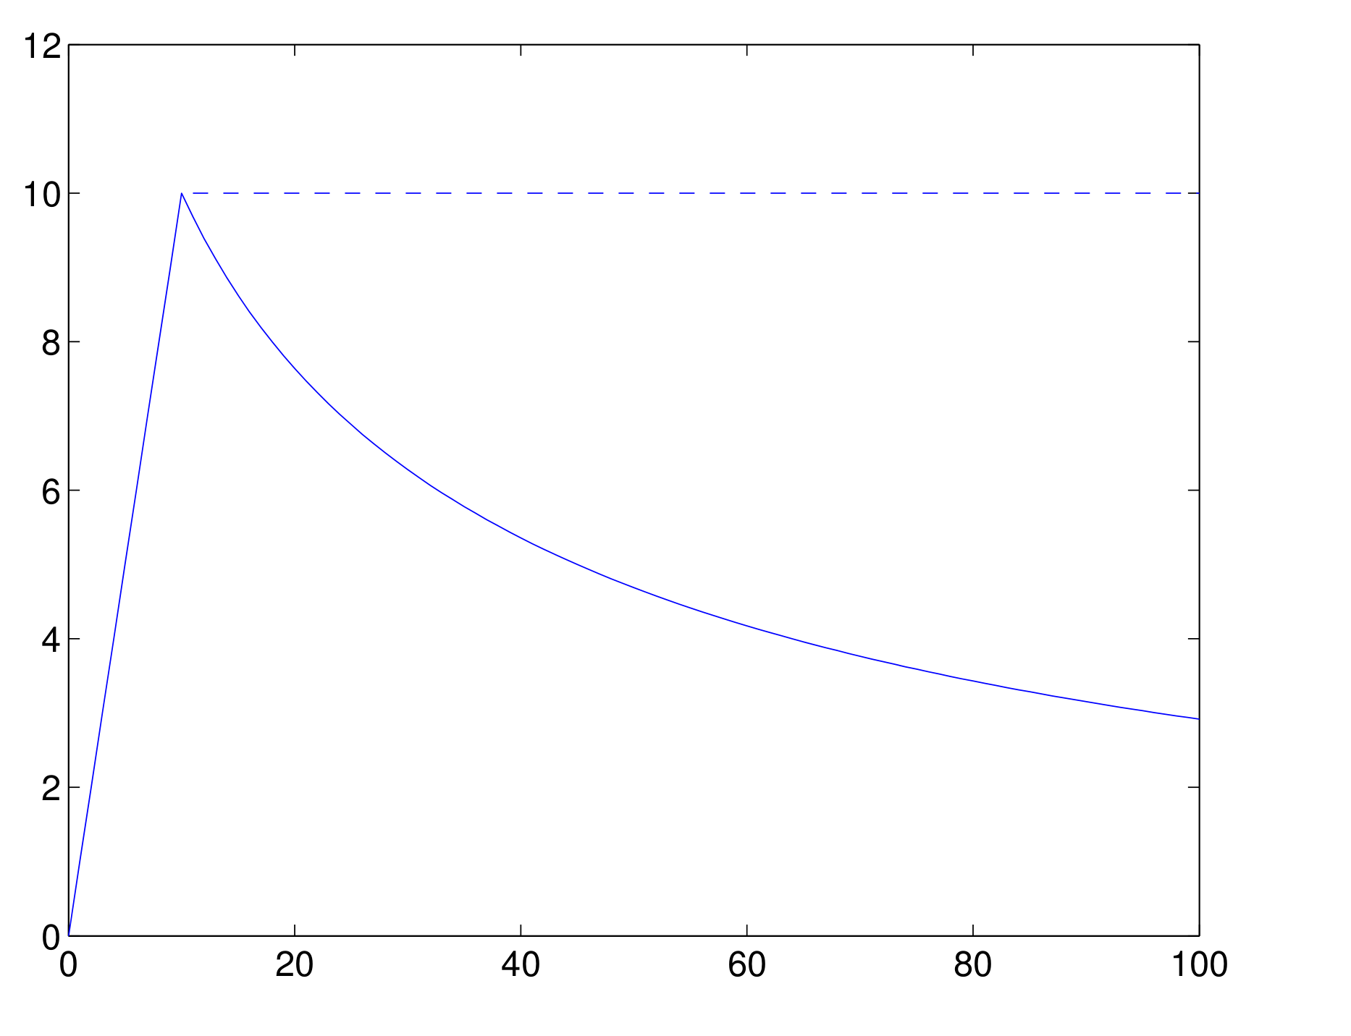
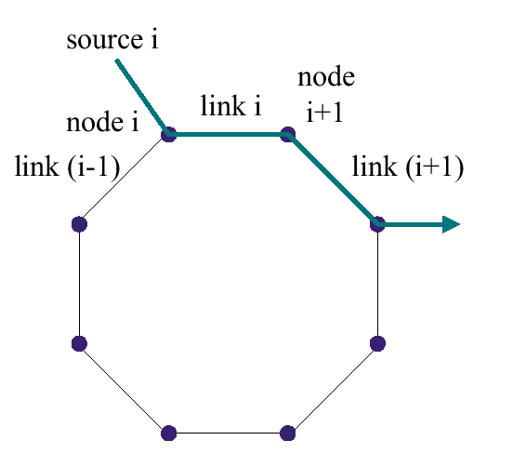
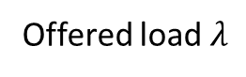
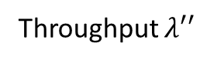
Throughput $λ′′$
With congestion control (TCP instead of UDP)
λ_{i}
λ_{i}’
λ_{i}”
Congestion collapse (with UDP)
λ_{i}”
Offered load $λ$

Slide 41
Congestion Collapse
Definition: Offered load increases, work done decreases
Frequent in complex systems
May be due to
Cost per job increases with load
Impatience (jobs leave before completion)
Rejection of jobs before completion
Designer must do something to avoid congestion collapse
Eg. Admission control in web servers
Eg. TCP congestion control
Analyst must look for congestion collapse

Slide 42
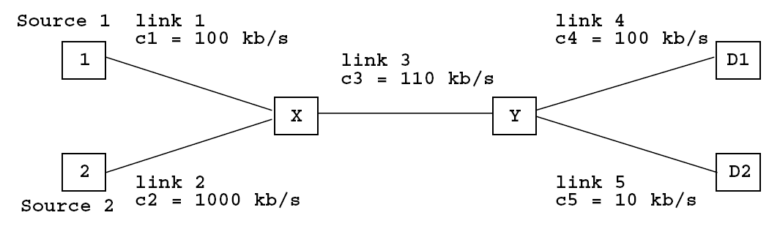
Sources use TCP (= fair scheduling). Increase capacity of link 5 to 100 kb/s; what happens to source 1 ?
100 kb/s
Its rate increases
Its rate decreases
Nothing happens
I don’t know

Slide 43
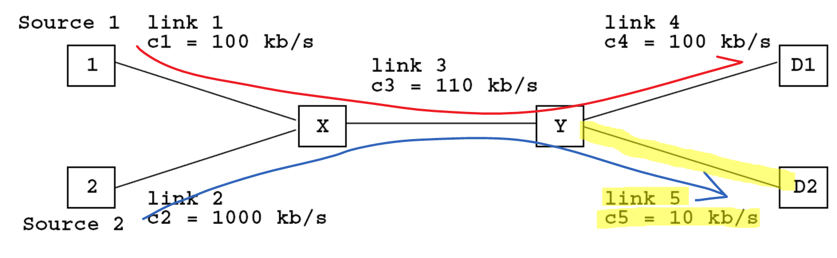
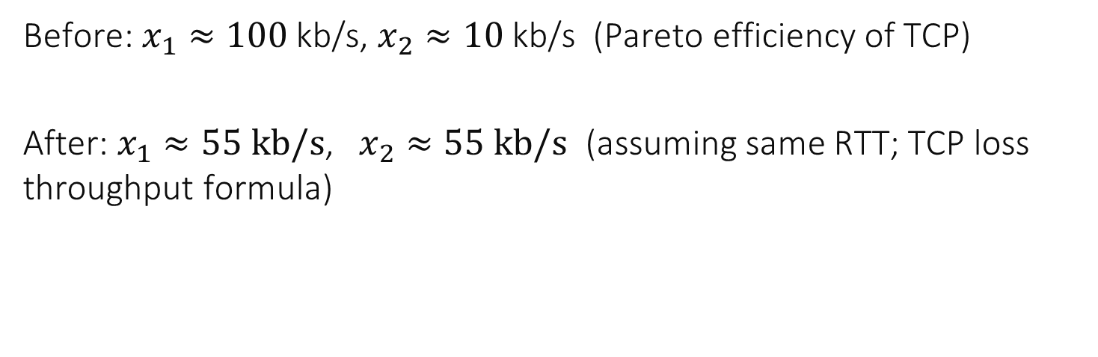
Solution
100 kb/s
Before: $x_{1}≈100$ kb/s, $x_{2}≈10$ kb/s (Pareto efficiency of TCP)
After: $x_{1}≈55 kb/s$, $x_{2}≈55 kb/s$ (assuming same RTT; TCP loss throughput formula)

Slide 44
Competition Side Effect
System balances resources according to some scheduling
Putting more resources changes the outcome of the scheduling
Apparent paradox: put more resources, some get less

Slide 45
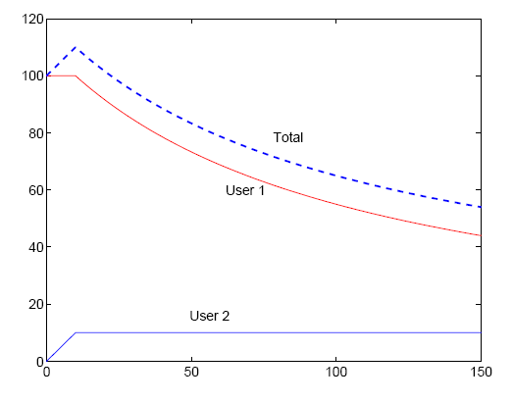
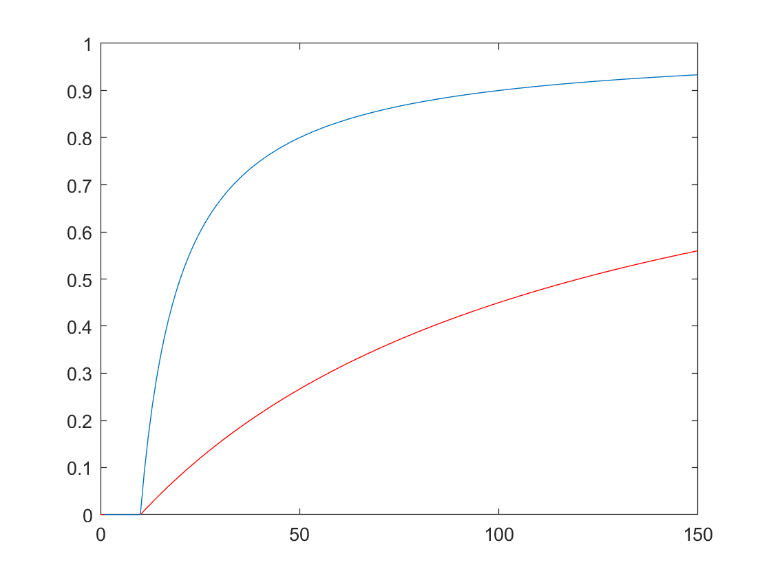


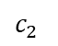
UDP (no congestion control), users send as much as they can Increase capacity of link 2 from 10 to 1000 kb/s
10 kb/s to 1’000kb/s
throughput
When capacity of link 2 increases beyond 10 kb/s,
throughput decreases for User 1
throughput remains same and loss increases for User 2
loss ratio
User 2
User 1
$$c_{2}$$
$$c_{2}$$

Slide 46
Latent Congestion Collapse
System is susceptible to congestion collapse
Some bottleneck (low speed access for source 2) prevents congestion collapse
Adding resources reveals congestion collapse
Apparent paradox: put more resources, all get less

Slide 47
Take Home Message
Watch for patterns, they are very frequent
Bottlenecks
Congestion collapse
Competition side effects
Latent Congestion collapse

Slide 48
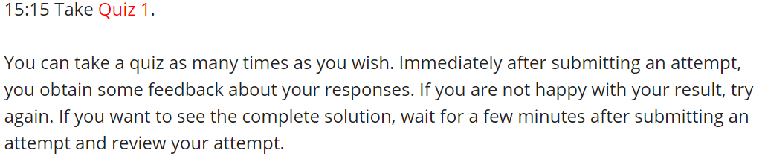

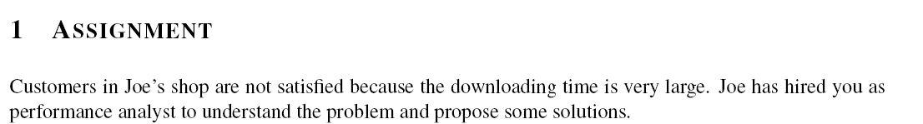
Now it’s your turn…

